Slide 1
Module 17
Describing
Serials and Integrating Resources
RDA Training
University of Nevada, Las Vegas
May 2013
Notes:
This module is intended to cover special procedures for audio recordings that differ from books. We’ve already covered thoroughly how to describe a book. We won’t go over all that again, exept to note when you do the same thing for an audio recording.

Slide 2
Please log in to RDA
Please feel free to sign up later for a month’s free access so you can practice (see handout)
Notes:
From now on, as I show slides of RDA, please feel free to go ahead and look yourself in the Toolkit.

Slide 3
Mode of Issuance
Serial?
  A resource issued in successive parts, usually bearing numbering, that has no predetermined conclusion
Integrating resource?
  A resource that is added to or changed by means of updates that do not remain discrete but are integrated into the whole. May be tangible (e.g. loose-leaf) or intangible (e.g. updating website)

Slide 4
Basis for Identification
RDA 2.1
Serial
  The first part
Integrating resource
  a source of information identifying the current iteration of the resource as a whole.
Notes:
This module only covers monographs.

Slide 5
Preferred Source of Information
RDA 2.2.2
Based on the format (see previous modules)
Notes:
Serials and integrating resources can exist in nearly any format. A print serial’s preferred source of information would be the title page of the first part, for example. An online integrating resource’s preferred source of information would be embedded metadata.

Slide 6
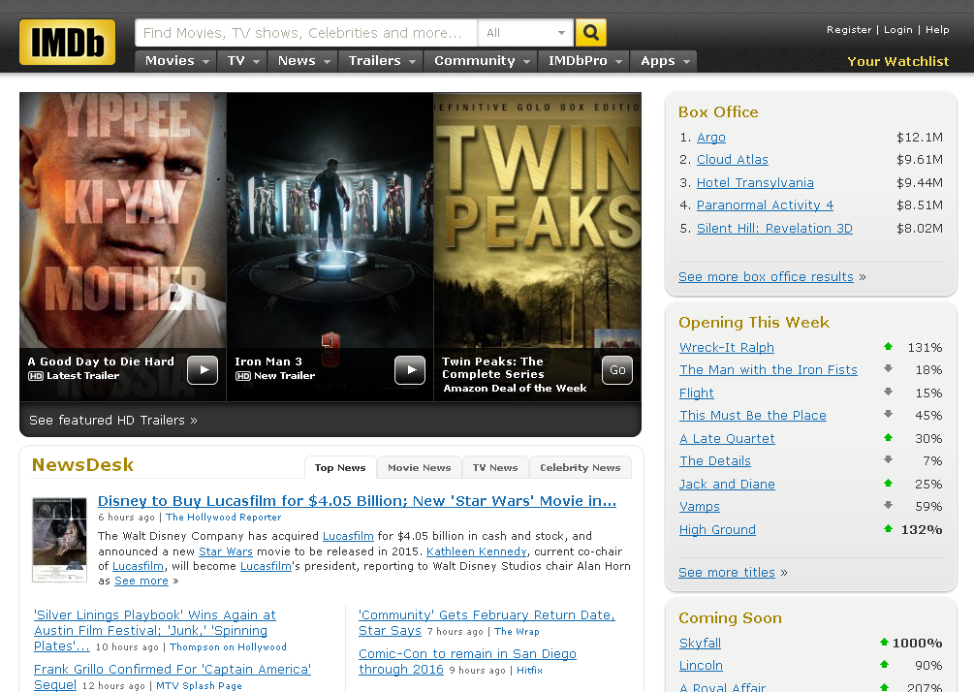
Preferred source

Slide 7
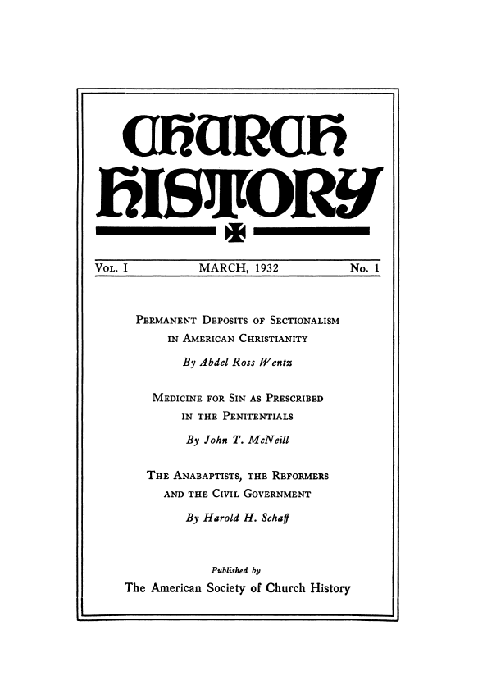
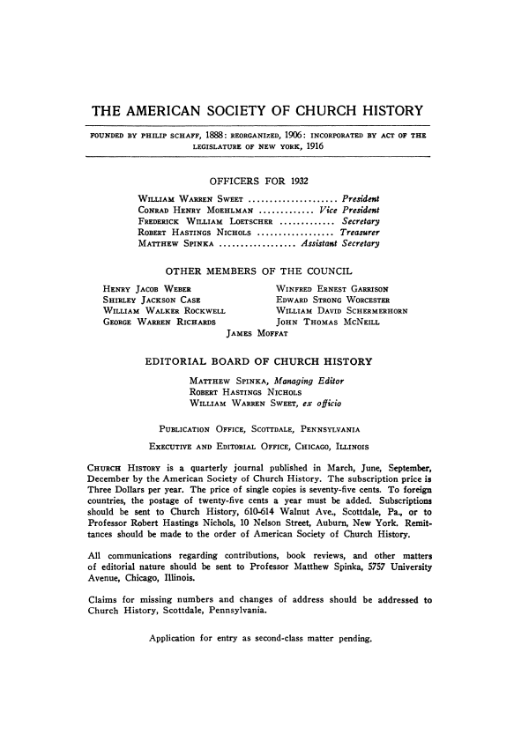
Preferred source
Notes:
http://www.jstor.org/stable/i358473

Slide 8
Title
Transcribe the title proper, parallel title proper and other title information exactly as found on the preferred source.
  245 00 $a IMDb
  245 00 $a Church history

Slide 9
Change in Title
Serials
  Minor change, make a note
  Major change (2.3.2.13.1), make a new description (record)
      the addition, deletion, change, or reordering of any of the first five words (the first six words if the title begins with an article)
      the addition, deletion, or change of any word after the first five words (the first six words if the title begins with an article) that changes the meaning of the title or indicates a different subject matter
      a change in a corporate body name given anywhere in the title if it is a different corporate body.
Notes:
Since serials and integrating resources exist over time, aspects of them can change, including their title.

Slide 10
Change in Title
Integrating resources
  Revise the title proper in the current description
  Record the earlier title as a variant if you think it will remain important for access to the resource
      Record as found
      245 00 $a Internet movie database : $b IMDb.
      Record as revised
      245 00 $a IMDb.
      247 11 $a Internet movie database
Notes:
The Internet Movie Database originally had that title as well as “IMDb” on its title screen. It was originally cataloged with the title “Internet Movie Database.” [Click]
Pause here to talk about 2.3.2.5 Exception for serials and integrating resources. Read together.
Some time after the resource was cataloged, the spelled-out name was completely dropped from the title screen of the resource. It now is only known as IMDb. The 245 is changed to the new title. But since the resource is still well known by the earlier name, it is retained in 247.

Slide 11
Variant title
Variant titles are not core. Record any variant titles you think would help a library user find the resource in a 246 field
      245 00 $a IMDb.
      247 11 $a Internet movie database
Notes:
We’ve already seen the older title here recorded as a variant.

Slide 12


Variant title
    245 00 $a Church history
    246 1 $i Volumes for March 1998- have title: $a Church history, studies in Christianity & culture
Notes:
Here the cataloger thought the addition of the subtitle was important for identification. Note the sleight of hand of the serials cataloger, pretending that the other title information is actually part of the title proper. Not sure that’s necessary.

Slide 13
Other Title Information
Other title information is not core.
Often not recorded for serials and integrating resources because prone to change.
Record if you think it is important for identifying the resource.
Do not record words relating to currency of contents or frequency. Record instead as frequency.
    245 04 $a The tribune : $b biweekly
    310 $a Biweekly
Notes:
Read exception under 2.3.4.3

Slide 14
Statement of Responsibility
First statement of responsibility is core
However, only record if the statement is unlikely to change from issue to issue
Do not record statements about editors, unless that information is considered an important means of identifying the serial (for example, one editor for the entire existence of the serial)
Notes:
Read the exception to 2.4.1.4.

Slide 15
Edition Statement
Transcribe any edition statement you find.
    245 00 $a Deseret news.
    250 $a Utah County edition.
Be careful, however. Sometimes the word “edition” is part of a numbering statement.
    245 10 $a Leading note : $b the magazine of the British Association for Music Therapy.
    362 1 $a Began with 1st edition, 2011
    588 $a Description based on: 1st edition.

Slide 16
Publication Statement
Record publication information as you find it.
Serials: based on first part
Integrating resources: based on current part
      245 00 $a Church history.
      264 _1 $a Scottdale, Pennsylvania ; $a Chicago, Illinois : $b The American Society of Church History, $c 1932-
      245 00 $a IMDb.
      264 _1 $a [Place of publication not identified] : $b IMDb, $c [1990]-

Slide 17
Copyright information
Copyright information is not core. It may be recorded in serial or integrating resource records, but this is not commonly done.
  264 -4 $c ©2005-

Slide 18
Extent (3.4)
Record the extent element according to the guidelines for the carrier
For serials, count bibliographic, not physical volumes
      300 $a 16 volumes
      300 $a 23 audio discs
      300 $a 1 online resource
Notes:
On bibliographic volumes, read 3.4.5.16

Slide 19
Extent (3.4.1.10)
If the resource is incomplete, either record the type of unit without a number
      300 $a volumes
      300 $a audio discs
Or, omit the extent element
Notes:
Read together 3.4.1.10. The LC practice is to omit extent for serials (generally) but not for multipart monographs or integrating resources. We’re not omitting extent in the examples for this workshop.

Slide 20
Extent (3.4.5.2, 3.4.5.19)
For an updating loose-leaf, record
      300 $a 1 volume (loose-leaf)
      300 $a 4 volumes (loose-leaf)
Notes:
Read together 3.4.5.2 and 3.4.5.19.

Slide 21
Illustrative and Color Content
(RDA 7.15, 7.17)
For serials, only record if illustrative content is prominent, i.e., more than an illustration every couple of issues
Record in subfield $b of 300, following a colon
    300 $a volumes : $b color illustrations
    300 $a 23 computer discs : $b graphs
    300 $a 1 online resource : $b maps (some color)
Note: RDA does not prescribe the spelling of “color”. LC will use “color,” not “colour.”
Notes:
Read 7.15 and 7.17. together

Slide 22
Dimensions (3.5)
The dimensions element is not core, but is core for LC except for serials and online electronic resources
Record dimensions according to the appropriate format in 3.5.1.4 (see previous modules)
If a serial has different sizes and dimensions are recorded, record the smallest and largest size (3.5.1.8.1)
If an integrating resource changes size, record the dimensions of the current iteration (3.5.1.8.2)
Notes:
Do not record dimensions for online resources.

Slide 23
Frequency (2.14)
Definition: the intervals at which parts of a serial or the updates to an integrating resource are issued.
Not core for RDA, but core for LC and PCC
Record using a term from 2.14.1.3, or make a note
Record in 310 subfield $a
Notes:
See 2.14.1.3

Slide 24
Frequency (2.14)
245 00 $a Church history.
310 $a Quarterly.
245 00 $a IMDb.
310 $a Updated daily.
Notes:
See 2.14.1.3

Slide 25
Content, media, and carrier type (3.2, 3.3, 6.9)
Record as appropriate to the resource
    245 00 $a IMDb.
    336 $a text $2 rdacontent
    336 $a still image $2 rdacontent
    336 $a two-dimensional moving image $2 rdacontent
    337 $a computer $2 rdamedia
    338 $a online resource $2 rdacarrier
    245 00 $a Church history.
    336 $a text $2 rdacontent
    337 $a unmediated $2 rdamedia
    338 $a volume $2 rdacarrier

Slide 26
Numbering of Serials (2.6)
Definition: “the identification of each of the issues or parts of a serial”
May include numerals, letters, or another character and a caption.
Must come from the first and/or last part
Notes:
EVERYONE go to 2.6. Read the definition.

Slide 27
Numbering of Serials (2.6)
Recording numbering
  Record the numeral following 1.8
    Form preferred by the cataloging agency
    LC’s preferred form is “record numerals in the form in which they appear on the source” (1.8.2 alternative)
  Transcribe other words (e.g. the caption) as they appear on the source
  Record in 362, first indicator “0”
Notes:
Go to 1.8 to remind us about policies for recording numerals; look at LCPS at 1.8.2.

Slide 28
Numbering of Serials (2.6)
Numeric designation
245 00 $a Church history.
362 0_ $a Vol. I, no. 1
Notes:
We’re not done here yet, but we’re recording the numeric designation of the first issue here, see 2.6.2

Slide 29
Numbering of Serials (2.6)
Chronological designation. Record in parentheses following the number
245 00 $a Church history.
362 0_ $a Vol. 1, no. 1 (March 1932)-
Notes:
We’re now recording the chronological designation of the first issue (see 2.6.3). We end with period at end of 362 because we don’t have a last issue.
If there were a last issue we’d do the same thing for it after the hyphen.

Slide 30
Numbering of Serials (2.6)
Alternative (2.6.2.3, etc.):
Make a note (2.20.5) on the numbering instead of recording the numbering of serials element
This is recorded in 362, first indicator “1”
LC and CONSER generally apply the alternative (note) although both practices may be seen.
The note is your only choice if you do not have the first and/or last issue.
Notes:
Look at 2.20.5 for some examples of how this note might be worded. Nothing is prescribed.

Slide 31
Numbering of Serials (2.6)
Alternative note
245 00 $a Church history.
362 1_ $a Began with Vol. 1, no. 1 (March 1932).

Slide 32
Other elements
Include other elements as appropriate to the resource (see earlier modules)
Selected possible other elements:
  Sound characteristic (3.16)
  Video characteristic (3.18)
  Digital file characteristic (3.19)
Notes:
For example, for a digital map, include scale statement, projection of cartographic content. You might also include sound characteristic elements, video characteristic elements, etc.

Slide 33
Series Statement (2.12)
Record series statement if present on the item (no different from any other format)
Series statements are rare in serials, but possible.

Slide 34
Notes
Record notes as appropriate.
  basis for identification and date of viewing (RDA 2.20.13, MARC 588)
      588 $a Description based on: vol. 1, no. 1 (March 1932)
      588 $a Latest issue consulted: vol. 75, no. 4 (Dec. 2006)
      588 $a Description based on version consulted 1 November 2012.
Notes:
Some typical notes in serial and IR records.

Slide 35
Notes
Record notes as appropriate.
  note on responsible entities or prominent editors (RDA 2.20.3, MARC 500)
      500 $a Issued by: American Society of Church History
      500 $a Founding editor: Matthew Spinka.
      500 $a IMDb was founded by Col Needham on October 17, 1990 as Internet Movie Database. See “IMDb20” within the website.
      500 $a “An amazon.com company.”
Notes:
Some typical notes in serial and IR records.

Slide 36
Notes
Record notes as appropriate.
  peculiarities in the numbering (RDA 2.20.5.4, MARC 515)
    515 $a Issues for August 1973–December 1974 also called v. 1, no. 7–v. 2, no. 12.
    515 $a Numbering irregular; some numbers repeated or omitted.
Notes:
Some typical notes in serial and IR records.

Slide 37
Notes
  245 00 $a IMDb.
  500 $a “An amazon.com company.”
  500 $a IMDb was founded by Col Needham on October 17, 1990 as Internet Movie Database. See “IMDb20” within the website.
  588 $a Description based on version consulted 1 November 2012.
Notes:
Some typical notes in serial and IR records.

Slide 38
Notes
245 00 $a Church history.
500 $a Issued by: American Society of Church History.
500 $a Founding editor: Matthew Spinka.
588 $a Description based on: vol. 1, no. 1 (March 1932)
588 $a Latest issue consulted: vol. 75, no. 4 (Dec. 2006)

Slide 39
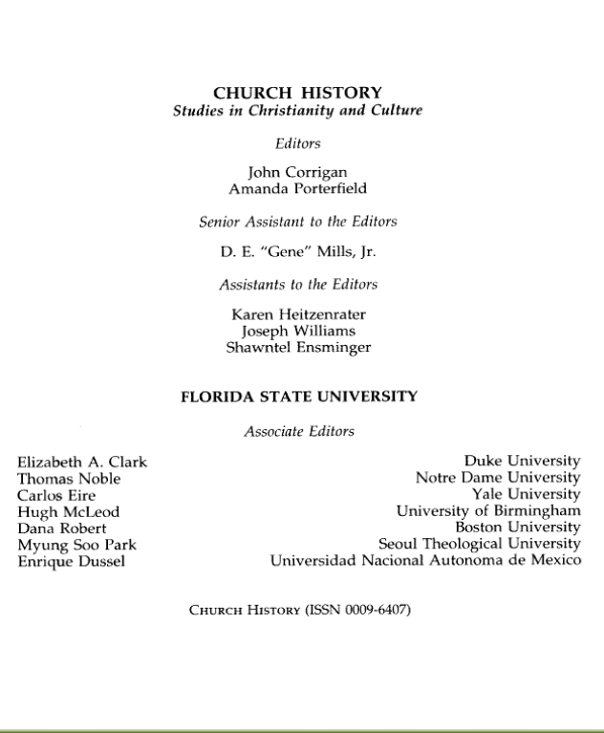
Identifier for the manifestation (2.15)
Record identifiers
  ISSN in 022
  Record exactly as found
    022 $a 0009-6407
    245 00 $a Church history.
Notes:
Title page verso, vol. 75, no. 4 (Dec. 2006)

Slide 40
URL (4.6)
For remote access resources, record the URL in 856 $u
    245 00 $a IMDB.
    856 42 $u http://bibpurl.oclc.org/web/273 $u http://www.imdb.com/

Slide 41
Record Relationships
Record the principal creator. Most serials do not have a principal creator (19.2.1.1.3), but a corporate body may qualify under 19.2.1.1.1.
    110 1 $a Connecticut. $b Department of Administrative Services, $a author.
    245 10 $a At your service : $b Connecticut Department of Administrative Services ... annual report.
Notes:
Read together 19.2.1.1.3. Neither of the resources we’ve been working on has a principal creator.

Slide 42
Record Relationships
Record the relationship of the resource to the work embodied in it.
  245 00 $a Church history.
  245 00 $a IMDb.
Notes:
Reminder: a serial or integrating resource is a work. The relationship is recorded by by embedding the authorized access point for the work in the record. For most serials the authorized access point for the work will be the preferred title for the work, and in most cases that will be identical to the title proper, so recording the title proper suffices to record the relationship of the resource to the work.

Slide 43
Record Relationships
Record other relationships you consider important.
    245 00 $a IMDb.
    700 1 $a Needham, Col, $d 1967- $e founder.
    710 2 $a IMDb.com, Inc., $e issuing body.
Notes:
Note: The relationship designator with Needham is not strictly speaking correct because that particular one is supposed to be used to denote the relationship between an entity and another person, family, or corporate body, not between an entity and a work. However, there isn’t currently any satisfactory relationship designator for what’s going on here in appendix I.

Slide 44
Record Relationships
Record other relationships you consider important.
245 00 $a Church history.
700 1_ $a Spinka, Matthew, $d 1890-1972, $e editor.
710 2_ $a American Society of Church History, $e issuing body.
Notes:
Note: The relationship designator with Needham is not strictly speaking correct because that particular one is supposed to be used to denote the relationship between an entity and another person, family, or corporate body, not between an entity and a work. However, there isn’t currently any satisfactory relationship designator for what’s going on here in appendix I.

Slide 45
Exercise
Work together to catalog serials or integrating resources workshop participants have brought, if any.

Slide 46
Module 17
Describing
Serials and Integrating Resources
Questions?
RDA Training
University of Nevada, Las Vegas
May 2013

Slide 47
This Presentation is available at
http://net.lib.byu.edu/~catalog/people/rlm/RDALV201305/index.htm
For further information
contact Robert L. Maxwell
robert_maxwell@byu.edu

